Slide 1
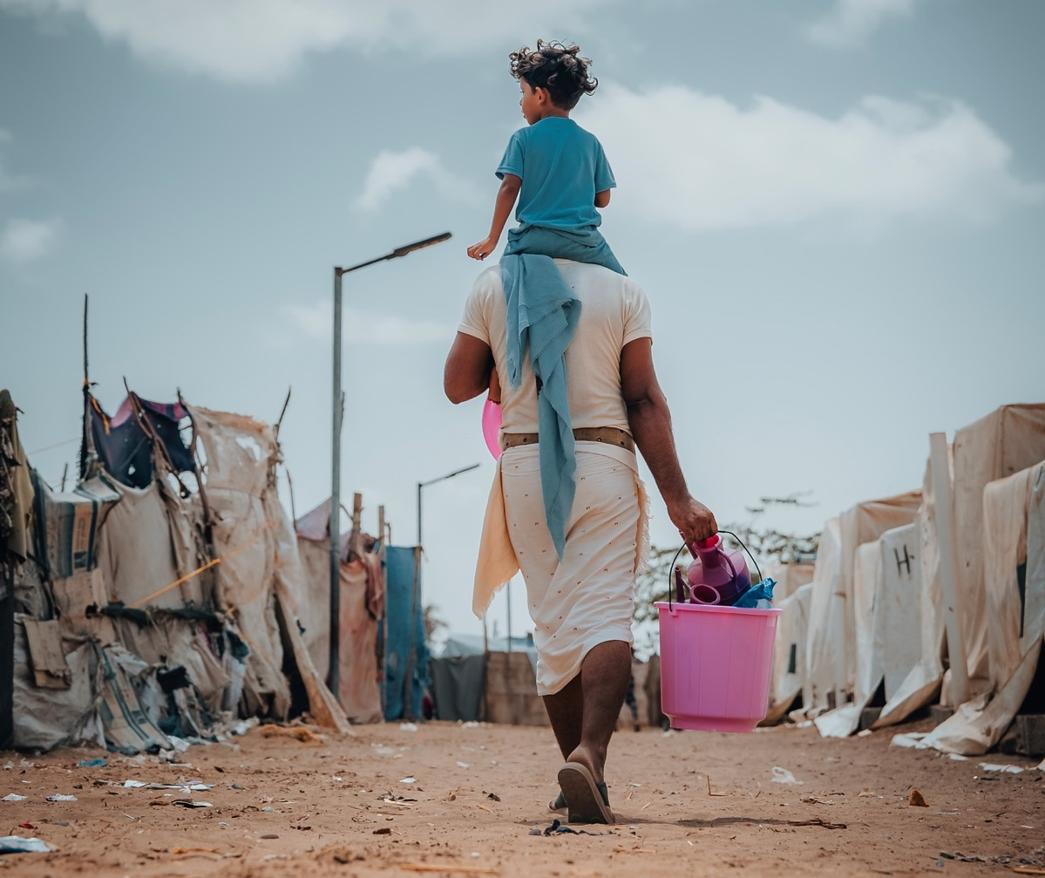
Concern Ambassadors
We are charity champions
Notes:
Hello, my name is ************ and I am part of your Concern Ambassador team
​
We are here to let you know about the charity Concern Worldwide and talk to you about your fundraising activity

Slide 2
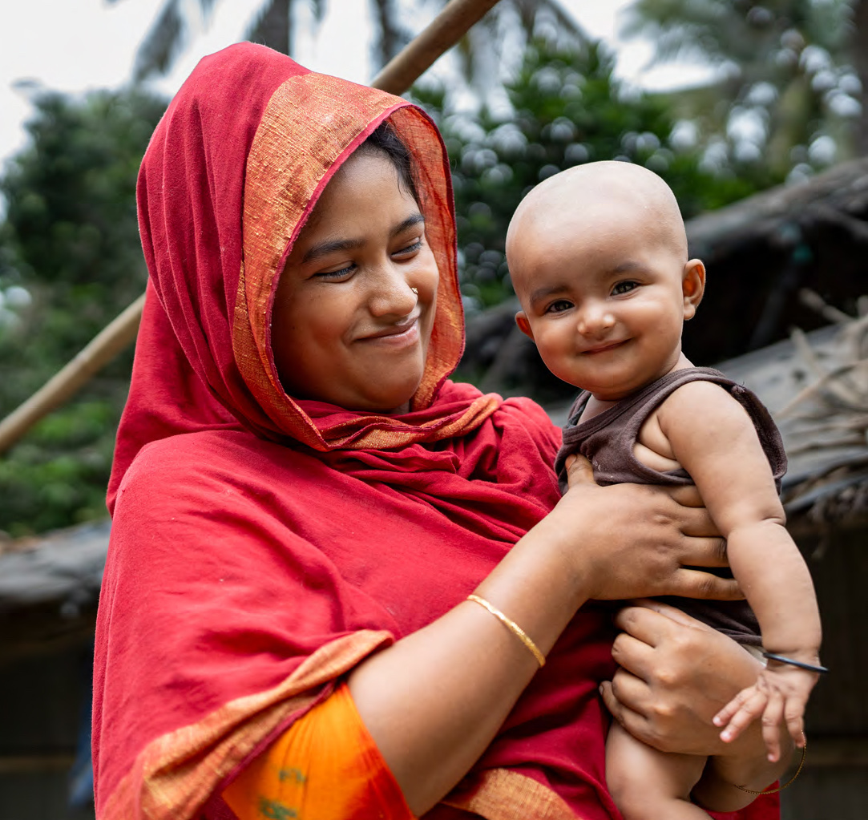
Our vision
A world where all people live in peace and prosperity and are treated equally, with dignity and respect.
Bangladesh: Marium* and her five-month-old daughter Tayma*
Notes:
Concern Worldwide is a charity dedicated to ending extreme poverty in the world’s poorest countries.
(If using video play the next video slide – if not, continue this reading out…)
Concern works on a range of programmes, working to end the causes of extreme poverty.
Concern delivers Health and Nutrition aid, Education and Gender Equality programmes and many more, and importantly, helps in global emergency events

Slide 3

Notes:
*TEST YOUR SOUND*
This short video helps explain Concern’s work

Slide 4
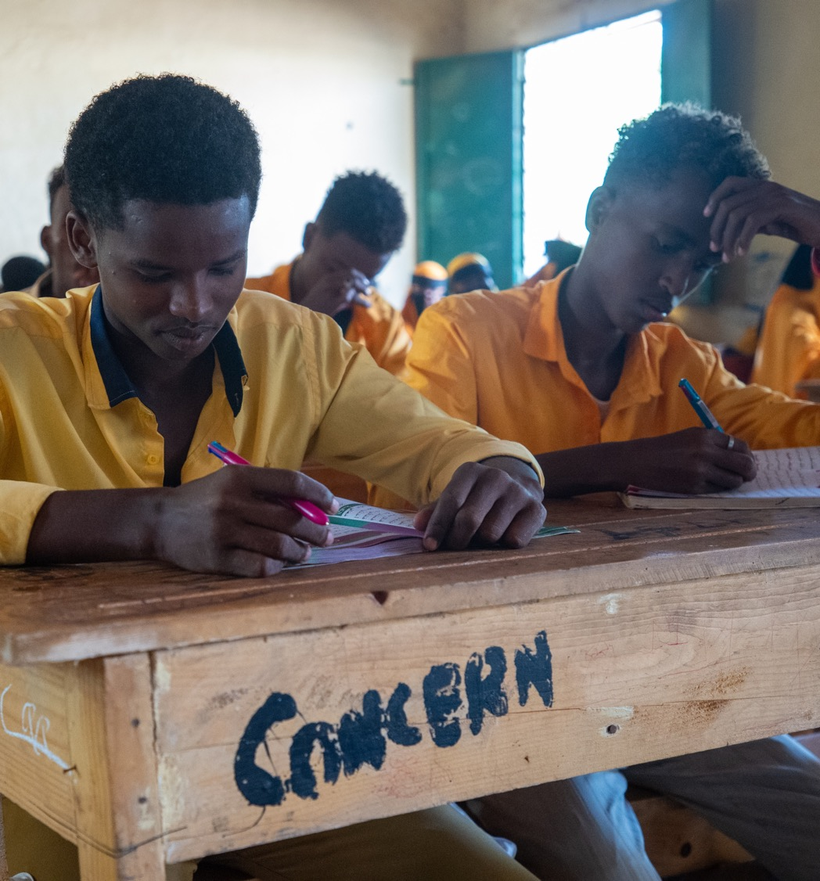
Education
30,000 vulnerable children provided with free education in displacement-affected communities in Somalia.
Somalia: Students in Afgooye school, supported by Concern
Notes:
One of the countries featured in the video was Somalia. This is Omar from Somalia, benefitting from Concern’s free education progamme.
Omar and others like him continue to need our support,, we need to raise funds to help other students like Omar receive the education they deserve, but also help displaced people of Gaza, help mothers feed their children in Yemen, or help people in Afghanistan affected by the recent earthquake

Slide 5





?
?
Notes:
Please insert your own notes here…
We are raising funds by….
You can support us by…..

Slide 6
Thank you
Notes:
We can do it – good luck!

