Slide 1
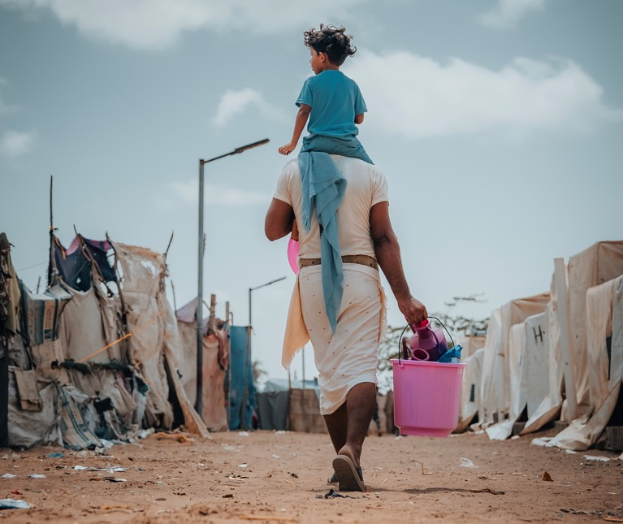
Concern Ambassadors
Be our charity champions
Notes:
We have a very interesting lesson today, we are going to become Concern Ambassadors and charity champions in (your school) community
First we will go through this short presentation, then as a group, we will work through the Ambassador pack

Slide 2

Today we will
Learn more about Concern’s work and what it means to be a Concern Ambassador
Discuss your Ambassador role and your fundraising plans
Notes:
Today we will (read slide)

Slide 3
Who we are
Concern Worldwide is an international, humanitarian, non-governmental organistion dedicated to the elimination
of extreme poverty and the reduction
of suffering, primarily in fragile countries.
Notes:
Class Question – Have you heard about; or seen Concern Worldwide on anywhere?
A - Yes – where & how, what do you think they do?
A – No – that’s fine because you will learn more about Concern after this lesson, they are (read slide)
Teacher tip (address the difference between relevant and absolute/extreme poverty) We have poverty in our own community but the communities Concern helps live in extreme or ‘absolute’ poverty with limited or no access to basic human rights, like health care or education – which you receive for free!
Lets watch a short video from Concern. To help better explain and illustrate their work (play video in next slide)

Slide 4

Notes:
SOUND ON for video (subtitles included). Press play
Class Questions – what are your thoughts on the video? Prompts…
Q – where do you think Concern works?
Q – what type of aid were they giving out?
Q – what kind of emergencies were Concern responding to in the video?

Slide 5
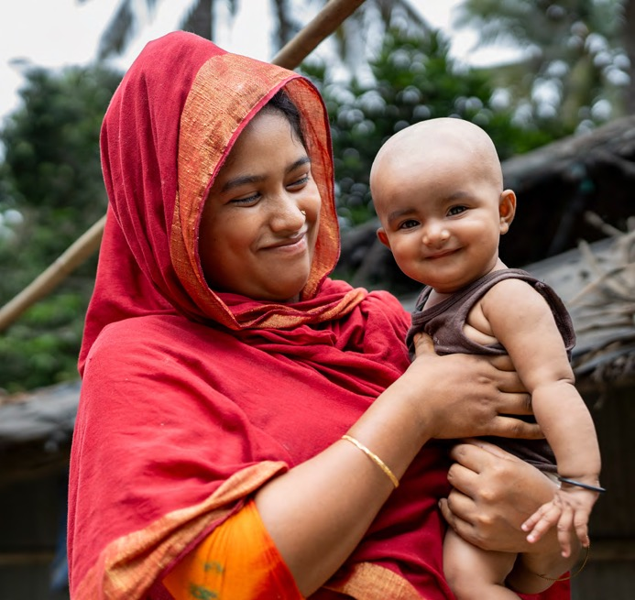
Our vision
A world where all people live in peace and prosperity and are treated equally, with dignity and respect.
Bangladesh: Marium* and her five-month-old daughter Tayma*
Notes:
So Concern’s vision is (read slide)
Teacher Tip – explain to the students how Concern’s vision fits your curriculum and/or your school ethos
E.g…
By being good global citizens and Concern Ambassadors for our school, we can support Concern’s Vision

Slide 6

Notes:
Some of you maybe familiar with this slide?
The United Nations Sustainable Development Goals are a blueprint (plan) to achieve a better (more sustainable) future for all.
They address the global challenges we face, including poverty, inequality, climate change, and the barriers to peace and justice. As a member country of the UN, the UK government have signed up to help achieve these goals.

Slide 7

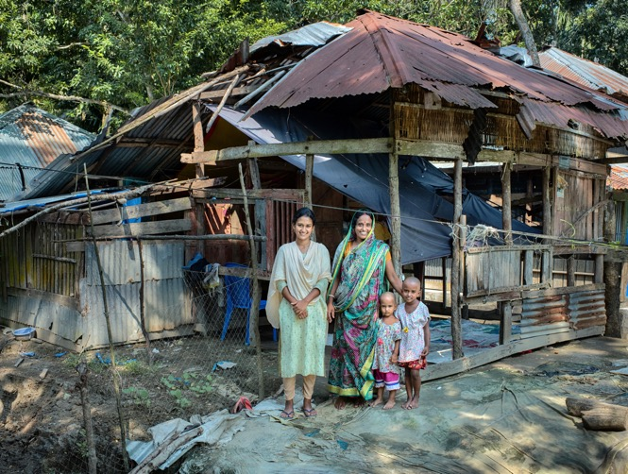
Rising costs, conflict situations and climate change are pushing
more people into
poverty
Photo by Mohammad Rakibul Hasan/ Concern Worldwide
Notes:
SDG1 aims to eradicate extreme poverty for all people everywhere, which closely aligns with Concerns mission
Teacher Tip – point out – at first glance, it may look like a family living in poverty but they are also happy, smiling family, well dressed – maybe we shouldn’t jump to conclusions about other communities

Slide 8



Promote peaceful and inclusive societies for sustainable development.
1 person died every 12 minutes because of global conflicts in 2024
Photo by Lisa Murray / Concern Worldwide
Notes:
SDG 16 focuses on several key areas, 2 of which are…
Access to Justice: Ensuring equal access to justice for all individuals – again aligning with Concern’s mission and vision
and
Promoting Peaceful Societies: Encouraging the reduction of violence and related deaths. As reported by the UN, 1 person died every 12 minutes because of global conflict events. Concern or their partners were involved in offering emergency and life-saving support to those affected by conflict

Slide 9
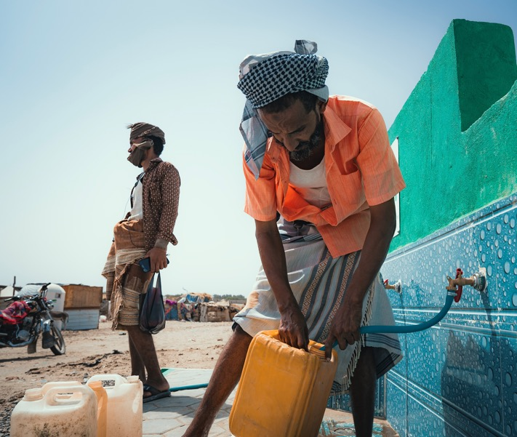
Emergencies
In 2024, we responded to 50 emergencies in 22 countries, reaching more than 6.8 million people directly and almost 10 million people indirectly.
Yemen: one of many water points that Concern has rehabilitated
Notes:
Concern responded to emergencies in the Middle East, in countries like, Gaza, and Afghanistan, Sudan and continues to work in places like Ukraine and Syria – shown here on (click to map)
(Extra Info….)
MAIN OBJECTIVES ARE TO:
Respond rapidly to save lives and reduce suffering
Improve access to food, shelter, healthcare and water
Prevent and reduce the impact of emergencies

Slide 10
Where we worked in 2024
Our Impact
in 2024
27.3m
  people reached
27
  fragile places
85.4%
  of donations go to our overseas programmes
Notes:
Would you know the names of some of these countries if they weren’t labelled? Concern worked in 27 countries last year, and provided aid to over 27 million people
(point to Somalia on map)
Somalia has faced many hardships and crisis, created by political instability, conflict, hunger, and climate change. Concern has worked here for 40 years with both emergency interventions and longer-term projects, such as educational programmes
Concern helped 30,000 vulnerable children by providing them with free education

Slide 11
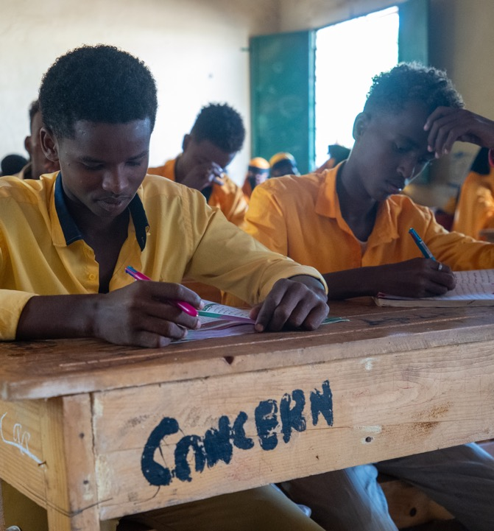
Education
30,000 vulnerable children provided with free education in displacement-affected communities in Somalia.
Somalia: Students in Afgooye school, supported by Concern
Notes:
You can see here and on our ambassador poster this is #Omar from Somalia benefitting from Concern's support
(for security reasons Omar isn't his real name) Is he the same age as you?
Omar and others like him continue to need your support, so that’s were we come in, we need to raise funds to help other students like Omar receive the education they deserve, but also help displaced people of Gaza, help mothers feed their children in Yeman, or help people in Afghanistan affected by the recent earthquake

Slide 12


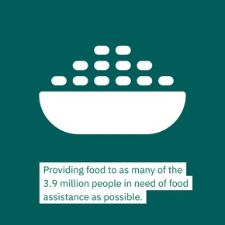

Notes:
Here are just some of the actions and aid Concern provides, from distributing hygiene kits, building shelters, providing clean water and food.
Concern need our help, funding this aid. Lets talk about Ambassador work…

Slide 13
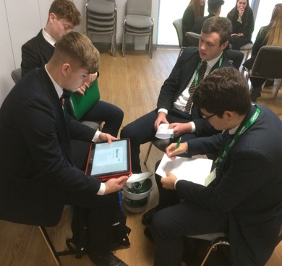
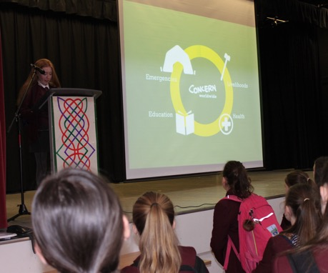
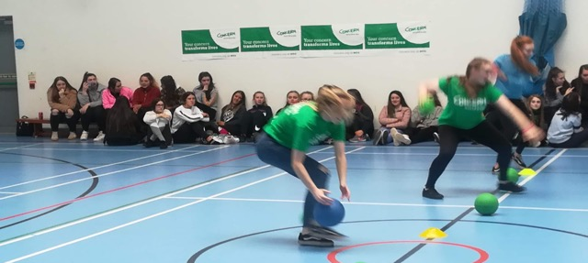
What will Concern Ambassadors do?
Plan: Organise fundraising activities
Campaign: Present a short PowerPoint
presentation to your school
Fundraise: Do a 24-hour sponsored challenge
Lodge your funds, check with your school
Notes:
Read slide
As Concern Ambassadors, you are now charity champions for Concern, you will campaign to raise awareness of Concerns work and raise vital life saving funds
To help 'campaign' you have your own Concern PowerPoint, its already created for you - with notes! All you have to do is present to your school community

Slide 14


CHALLENGE?
Notes:
The Concern 24hr challenge is our main schools fundraising campaign, taking place around the date of UNs Eradication of Poverty day which is Friday 17th October but if this doesn’t suit please do agree a date that works for you. Most schools pick their own.

Slide 15





?
?
Notes:
It is a 24 hour sponsored challenge – so you will go without something you need or love for 24 hours and ask your friends, family & neighbors for sponsorship money, what about a…
Digital detox can you go without your phone, tablet or any other digital device - could you ignore insta, give up gaming, lock up your phone – you might like it!
Which one will you pick?

Slide 16

Your Concern Pack Activities
What kind of 24-hour challenge you will do? What other activities can you do?
Choose a suitable date to do your challenge or FAST
How are you collecting sponsorship money?
Plan and organise your Concern presentation
When will you next meet up?
Notes:
Next will start our fundraising planning, and talk about what you can do – lets open your pack
(work through the Ambassador Worksheet)

Slide 17
Good luck!
Notes:
We can do it – good luck!

